Slide 1

BAHRAIN REFORMED BAPTIST CHURCH
The History and Theology of the Reformed Doctrine of Grace

Slide 2
“Those who cannot remember the past are condemned to repeat it.”
George Santanaya, The Life of Reason, 1905

Slide 3
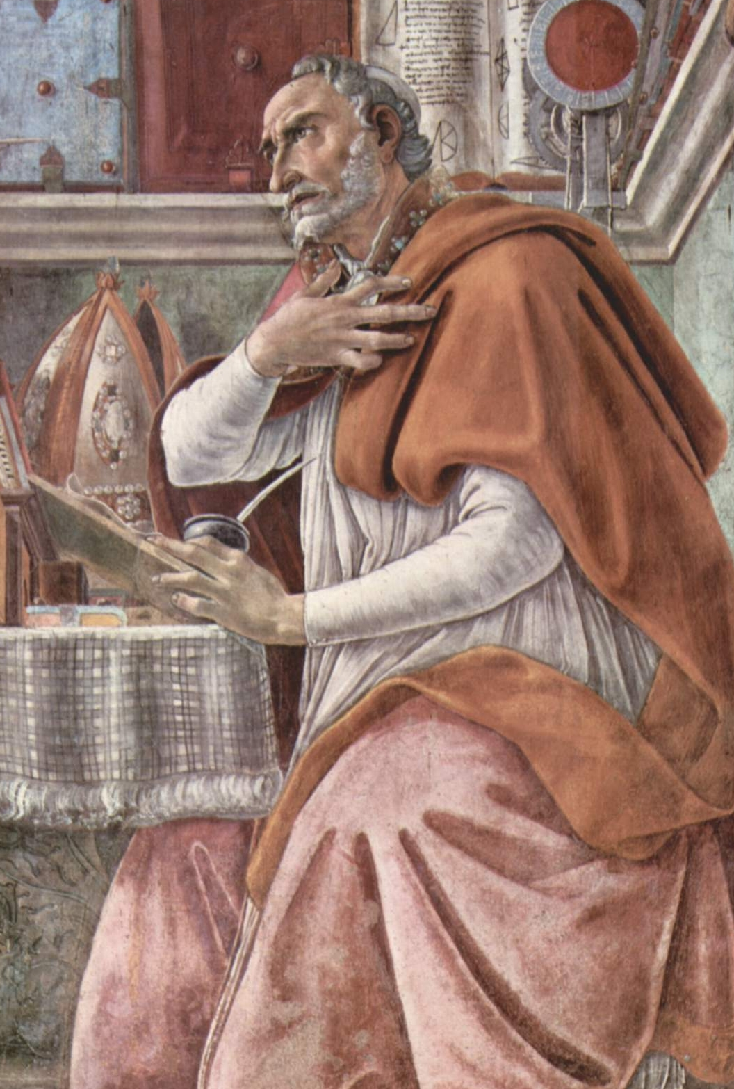
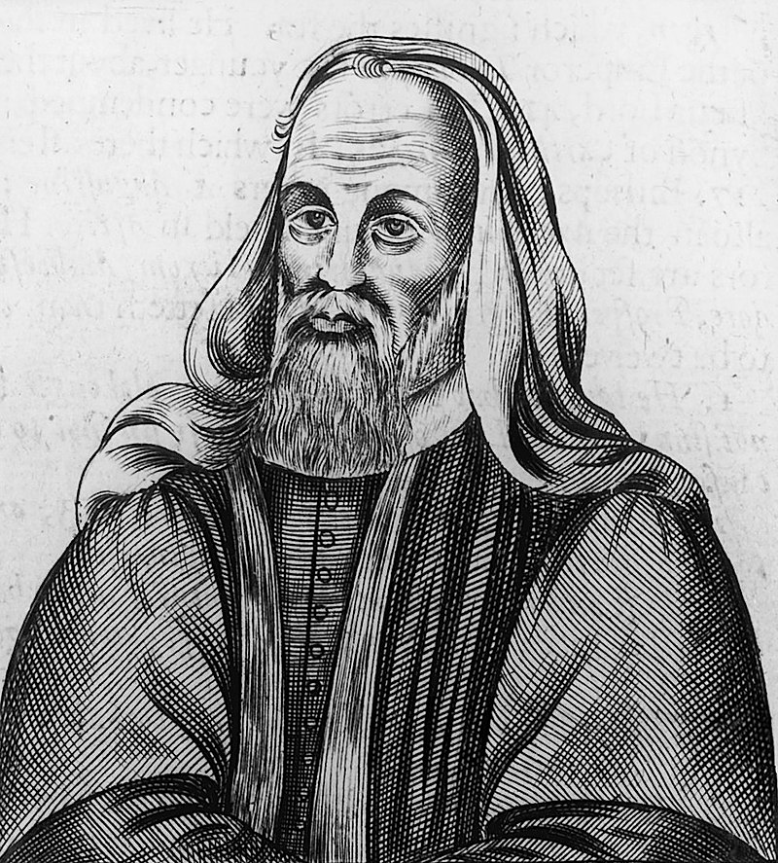
Controversy Over Free-Will
Augustine of Hippo
354 – 430 AD
Pelagius
354 – 420? AD

Slide 4
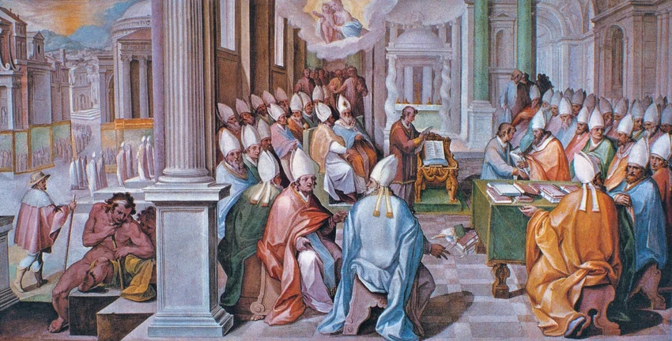
Council of Ephesus (431 AD)

Slide 5
“Lord, command whatever you will; and give us the grace to do what you command”
Augustine, The Confessions of: All Hope is in the Mercy of God, xxix, 40

Slide 6
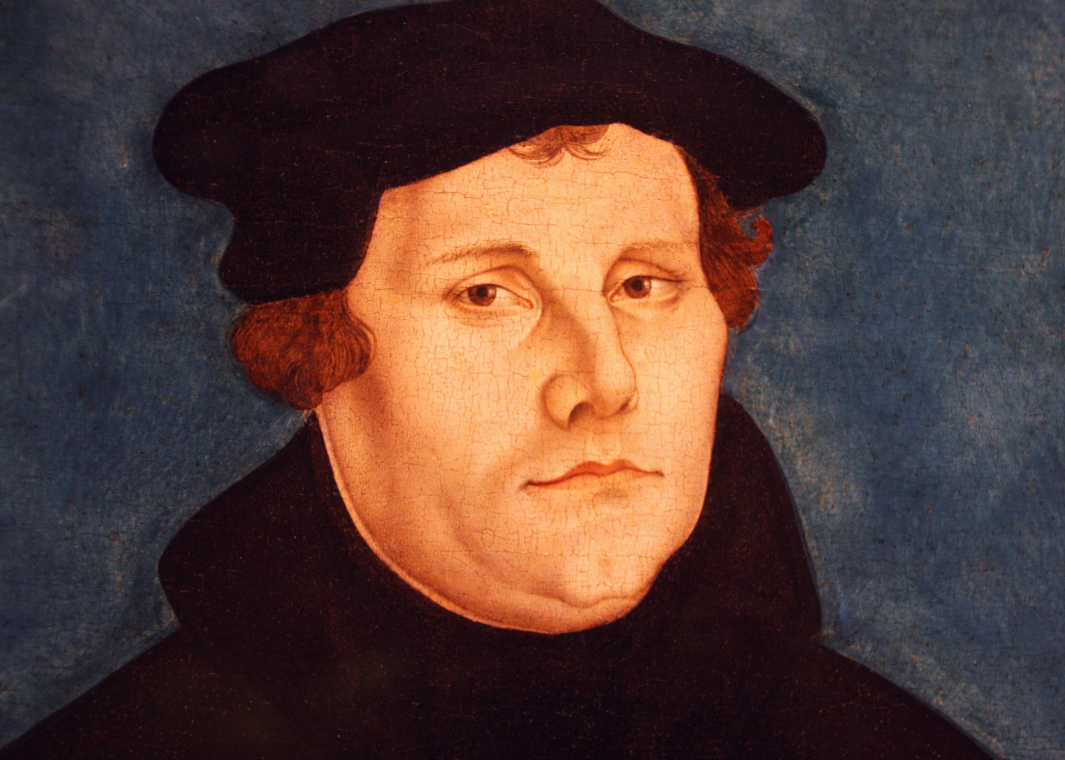
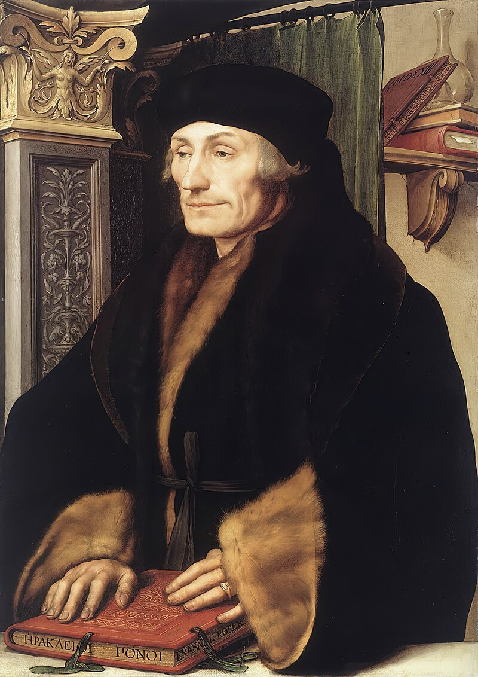
The Reformation: Semi-Pelagianism
Martin Luther
1483 – 1546
Desiderius Erasmus
1466 – 1536

Slide 7
Synergism: Syn = with; together with
Monergism: Mono = one/alone
Ergos – work

Slide 8
“… man of himself, or from his natural powers, cannot contribute ANYTHING or HELP to his conversion, and that conversion is not only in part, but altogether an operation, gift and present and work of the Holy Ghost alone, who accomplishes and effects it, by His virtue and power, through the Word, in the understanding, [of the] heart and will of man”
Book of Concord, Article II, Free Will: p.89

Slide 9
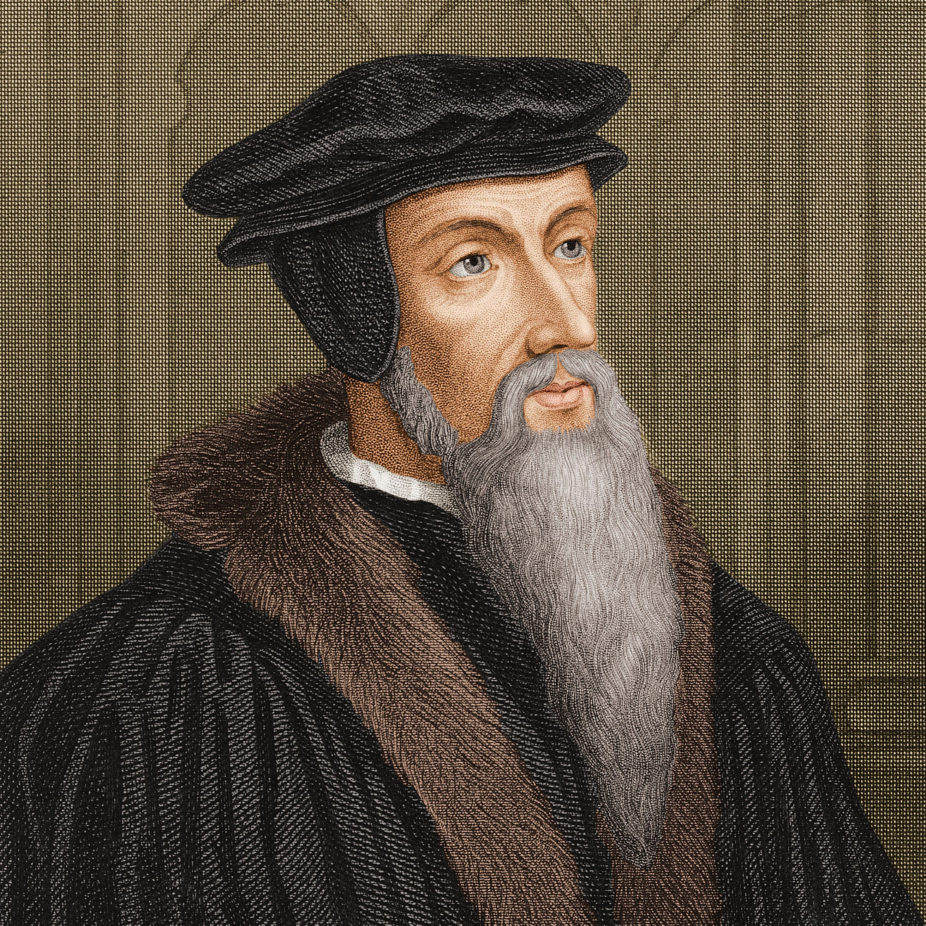
The Arminian vs Calvinist Controversy
John Calvin
1509 –1564
Jacobos “James” Arminius
1560 – 1609

Slide 10
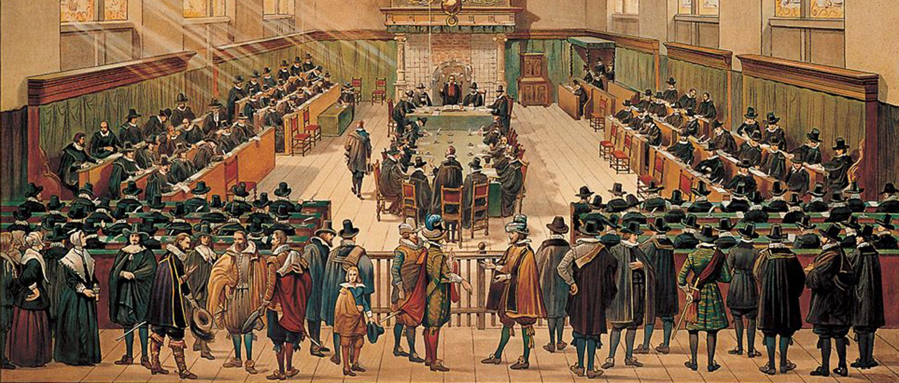
Synod of Dort (Netherland)
1618–1619

Slide 11
Synod of Dort’s Five Points of Calvinism
Total Depravity
Unconditional Election
Limited (Particular) Atonement
Irresistible Grace
Perseverance of the Saints

Slide 12
BAHRAIN REFORMED BAPTIST CHURCH
The History and Theology of the Reformed Doctrine of Grace

